Slide 1
Determining the Sentence
May 12, 2022
U.S. Sentencing Commission
Office of Education and Sentencing Practice
This presentation is produced and disseminated at U.S. taxpayer expense.

Slide 2
Learning Objectives
Your active engagement in this section will empower you to:
Apply the rules for undischarged, anticipated, and discharged sentences;
Describe the three-step sentencing process; and
Evaluate the applicability of departures and variances.

Slide 3
Multiple Sentence Problem
Loren Baker is currently serving a state sentence for sale of methamphetamine. After being sentenced in state court, the federal government charges her with conspiracy to distribute methamphetamine. The charged conspiracy is broader than, but includes, the sale of methamphetamine in state court.
Your goal is to have her entire state sentence count toward the federal sentence.

Slide 4
Essential Concepts
Primary Custody
Undischarged, Discharged, and Anticipated Sentences
Concurrent/Consecutive
BOP Sentence Computation

Slide 5
Primary Custody
The first sovereign to arrest the defendant has primary custody.
Sovereign may relinquish through:
  bail
  dismissal
  granting parole
  sentence completion
A writ is NOT a relinquishment of primary custody.

Slide 6
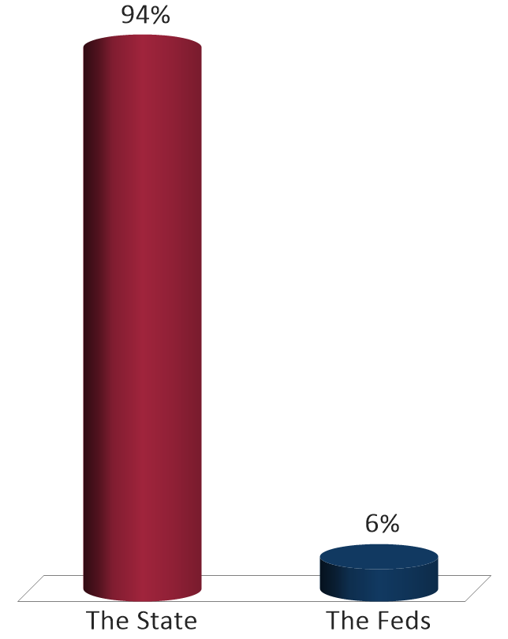
Loren Baker is currently serving a state sentence for sale of methamphetamine. After being sentenced in state court, the federal government charges her with conspiracy to distribute methamphetamine. The charged conspiracy is broader than, but includes, the sale of methamphetamine in state court.
Who has primary custody?
The State
The Feds

Slide 7
Primary Custody Matters
The sentence in the jurisdiction with primary custody must be served first.
The sentencing judge in the other jurisdiction determines when the
other sentence begins.
Concurrent?
Partially Concurrent?
Consecutive?

Slide 8
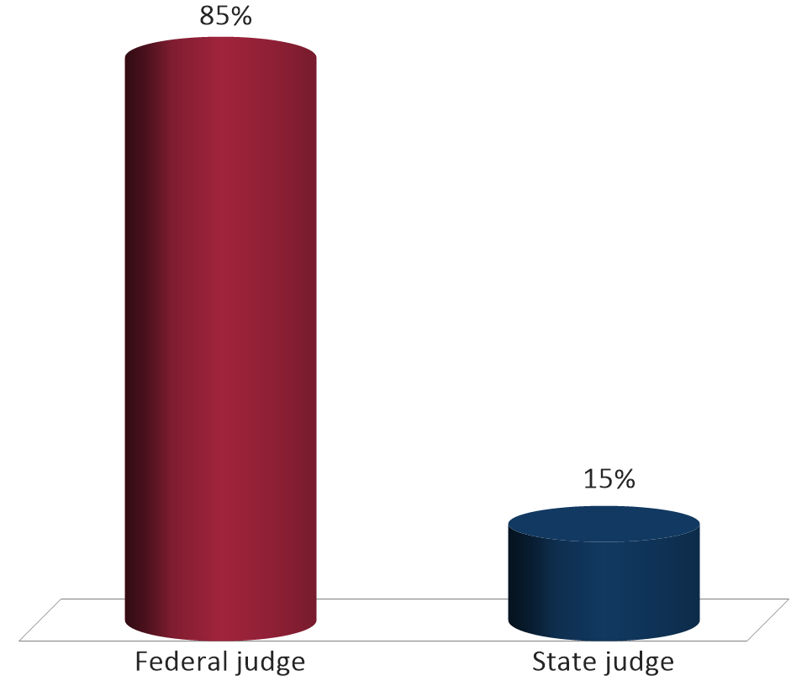
In our case, does the federal judge or state judge determine whether the sentences run concurrently or consecutively?
Federal judge
State judge

Slide 9
Calculation of Imprisonment Term
18 U.S.C. § 3585(a)
A sentence begins when the defendant:
is in custody awaiting transportation to serve the sentence; or
arrives voluntarily to commence service of sentence.

Slide 10
BOP Custody Credit
18 U.S.C. § 3585(b)
Official Detention:
for the instant offense
for any other charge not credited to another sentence
or

Slide 11
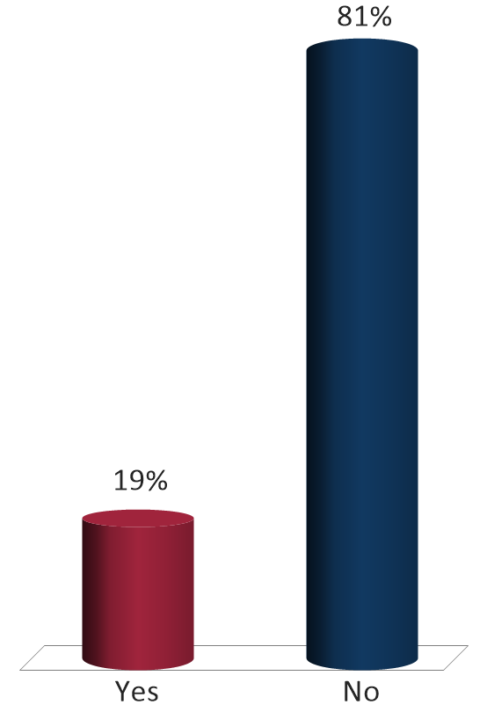
Loren Baker is currently serving a state sentence for sale of methamphetamine. After being sentenced in state court, the federal government charges her with conspiracy to distribute methamphetamine. The charged conspiracy is broader than, but includes, the sale of methamphetamine in state court.
Will the BOP credit Ms. Baker the time that she spent incarcerated before the date of her federal sentencing?
Yes
No

Slide 12
Undischarged Sentence §5G1.3(b)
RULE
a
Defendant Committed Offense
in Prison
RULE
b
Undischarged Sentence /
Relevant Conduct
RULE
c
Anticipated State Sentence /
Relevant Conduct
RULE
d
Catch-all Provision

Slide 13
§5G1.3(b) Concepts
Must be relevant conduct under §1B1.3(a)(1), (a)(2), (a)(3).
Must be an undischarged term.
Must “adjust” sentence by time not credited by BOP.
May adjust below mandatory minimum.
Must order remaining period to be served concurrently.
This mechanism should be noted clearly on the judgment.

Slide 14

Multiple Sentence Problem
Loren Baker
Term already served
Time Remaining to Serve
12 Months
12 Months
State Sentence
63 Months
51 Months
Concurrent to State Sentence
Federal Sentence

Slide 15
Discharged Terms of Imprisonment
§5K2.23 (p. 485)
Downward departure if:
Defendant completed sentence of imprisonment; AND
§5G1.3(b) would have applied otherwise.
Notes:
United States v. Fisher, 25 F.4th 1080, 1087 (8th Cir. 2022) (holding that §5K2.23 does not authorize a court to downwardly depart below a statutory minimum penalty).

Slide 16
Undischarged and Anticipated §5G1.3
RULE
a
Defendant Committed Offense
in Prison
RULE
b
Undischarged Sentence /
Relevant Conduct
RULE
c
Anticipated State Sentence /
Relevant Conduct
RULE
d
Catch-all Provision

Slide 17
Catch-All Provision
RULE
a
Defendant Committed Offense
in Prison
RULE
b
Undischarged Sentence /
Relevant Conduct
RULE
c
Anticipated State Sentence /
Relevant Conduct
RULE
d
Catch-all Provision
Notes:
United States v. Nelson, 982 F.3d 1141 (8th Cir. 2020). USSG §5G1.3(d) applies to a defendant subject to an undischarged term of imprisonment for relevant and non-relevant conduct, and in such cases, a court may choose to run the sentence for the instant offense concurrently, partially concurrently, or consecutively to the undischarged term of imprisonment.

Slide 18
Departures and Variances

Slide 19
3-Step Approach to Federal Sentencing
Guidelines
Departures
Variances
Notes:
19
19
19

Slide 20
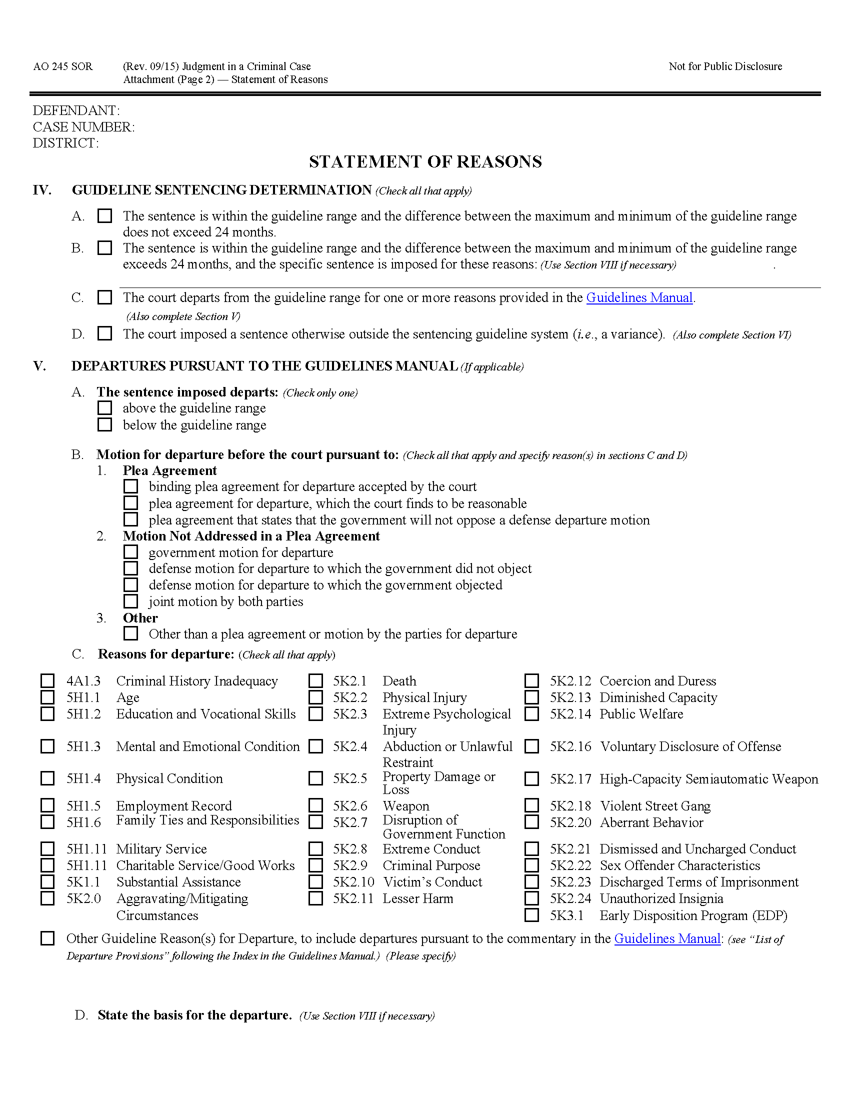
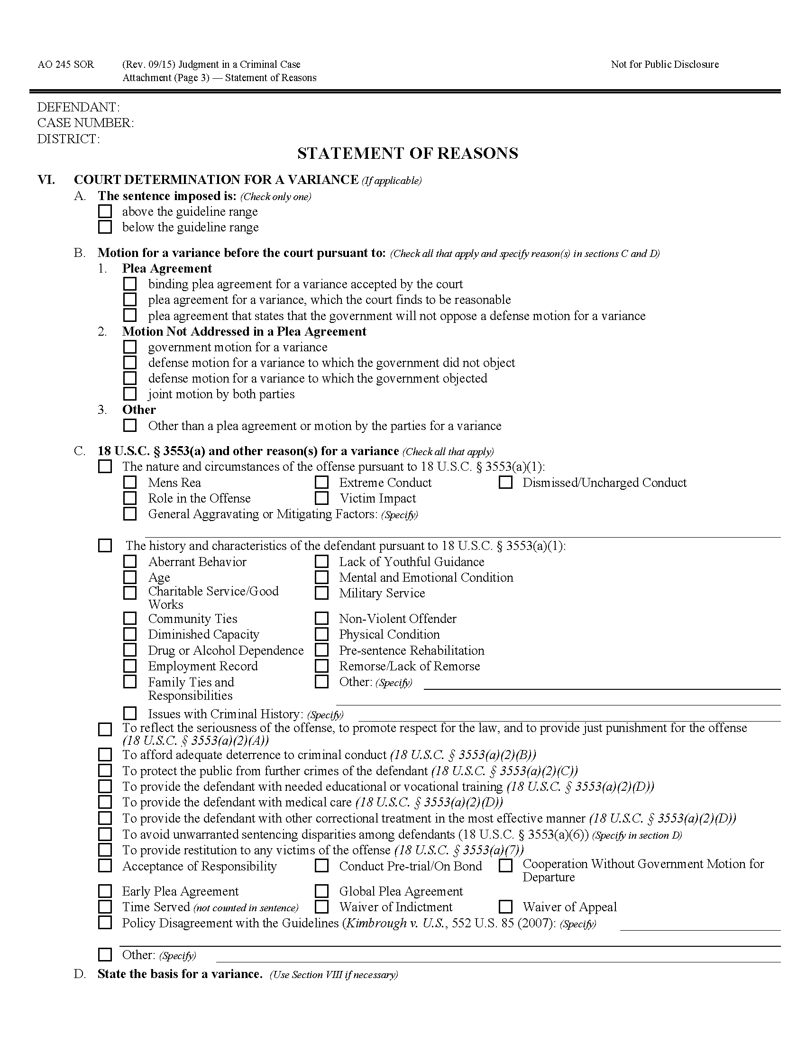
Statement of Reasons

Slide 21
Departures
§1B1.1, App. Note 1(F) (p. 18)
Downward Departure
GL Range
A sentence outside of, or different from, the Guidelines range; or
24mo
12mo
15mo
21mo
Upward
Departure
An assignment of a different criminal history category under §4A1.3.
III
Notes:
Fed. R. Crim. P. 32(h) – notice requirements – PSR, sentencing memo, court.
Page 597 of guidelines manual.

Slide 22
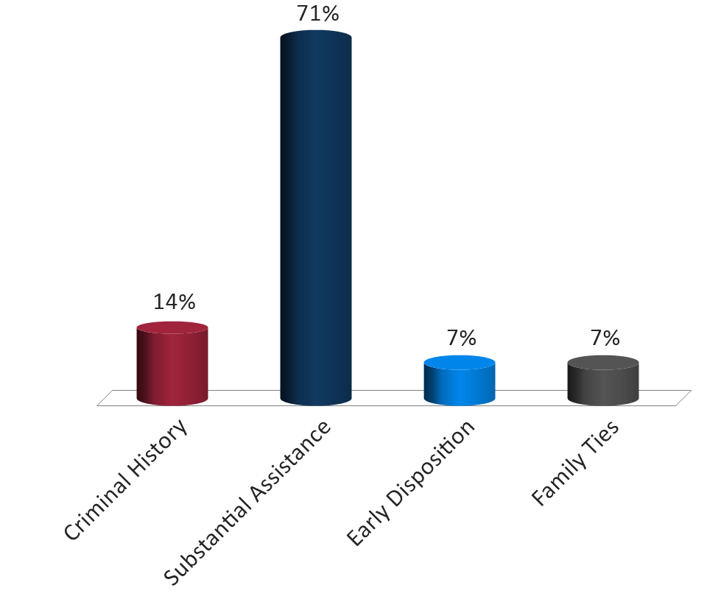
In FY 2020, what is the most cited basis for a downward departure?
Criminal History
Substantial Assistance
Early Disposition
Family Ties

Slide 23
Top 10 Reasons for Departure
Fiscal Year 2021
Downward Departure
Early disposition program
Substantial assistance with government motion
The history and characteristics of the defendant
Criminal history
General mitigating circumstances
Family ties responsibilities
Reflect seriousness of offense/promotes respect for law just punishment
Afford adequate deterrence to criminal conduct
COVID-19/pandemic
The nature and circumstance of the offense
Notes:
23
23
23

Slide 24
Variance
§1B1.1, Background (p. 20)
A sentence imposed outside of the guidelines framework.
Guidelines Framework
Downward Departure
GL Range
30mo
Downward Variance
24mo
12mo
Upward
Variance
15mo
21mo
Upward
Departure
6mo

Slide 25
18 U.S.C. § 3553(a)
Purposes
Punishment
Deterrence
Incapacitation
Rehabilitation
The court shall impose a sentence sufficient, but not greater than necessary, to comply with the purposes of sentencing.
Notes:
The umbrella of 3553(a).

Slide 26
What else must a court consider?
History and Characteristics
Restitution
Nature and Circumstances of the Offense
§ 3553(a)(1)-(7)
Unwarranted Sentencing Disparities
Purposes of Sentencing
Policy Statements
Kinds of Sentences
Guidelines

Slide 27
Top 10 Reasons for Variance
Fiscal Year 2021
Downward Variance
The history and characteristics of the defendant
Reflect seriousness of offense/promotes respect for law just punishment
Afford adequate deterrence to criminal conduct
The nature and circumstance of the offense
Protect public from further crimes
Criminal history issues
Family ties responsibilities
Avoid unwarranted sentencing disparity
Drug dependence/alcohol abuse
Age
Notes:
27
27
No procedural notice requirement for variance, but best practices are always notice.
27

Slide 28
Defendant and Family Interviews
Medical Records/Evaluations
Mental Health Treatment
Supporting Departures and Variances
Substance Abuse Treatment
Educational Records
Military Service Records
Employment Records
Financial Records

Slide 29
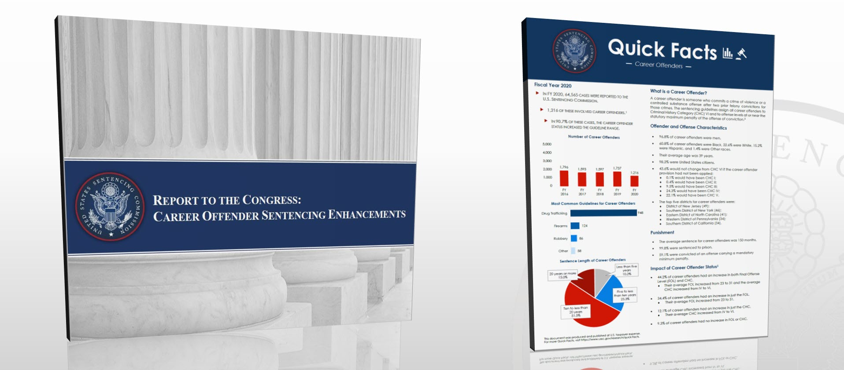
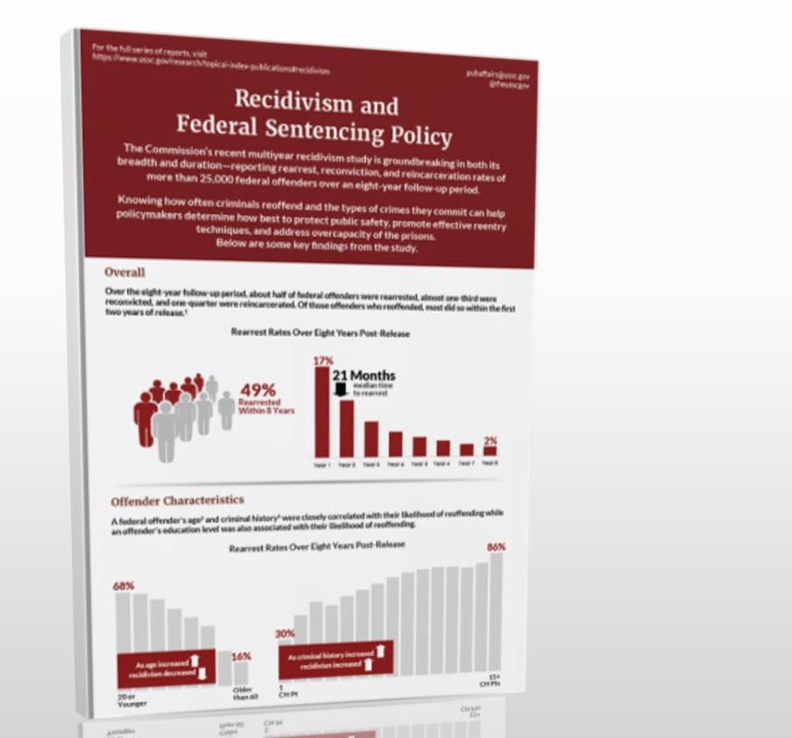
Commission Reports
Notes:
29
29

Slide 30
Learning Outcomes
You should now be able to:
Apply the rules for undischarged, anticipated, and discharged sentences;
Describe the three-step sentencing process; and
Evaluate the applicability of departures and variances.

Slide 31
Questions or Comments?

