Slide 1
Drugs and Guns
May 12, 2022
U.S. Sentencing Commission
Office of Education and Sentencing Practice
This presentation is produced and disseminated at U.S. taxpayer expense.

Slide 2
Ross Thomas
Senior Attorney
rthomas@ussc.gov
Peter Madsen
Senior Education and Sentencing Practice Specialist
pmadsen@ussc.gov
Office of Education and Sentencing Practice
HelpLine – (202) 502-4545
Online HelpLine Form

Slide 3
Learning Objectives
Your active engagement in this session will empower you to:
Describe relevant conduct principles in drug and gun offenses;
Apply common specific offense characteristics in drug offenses;
Apply common specific offense characteristics in firearms offenses;
Identify common applications issues when the offense involves drugs and firearms.

Slide 4
Relevant Conduct Rules in
Drug and Gun Cases

Slide 5
Relevant Conduct Analysis (a)(1) and (a)(2)
WHO:
(a)(1)(A): Acts of the defendant
(a)(1)(B): Certain acts of others (3-part analysis)
WHEN:
Offense of Conviction
(a)(1):
In preparation
During
Avoiding detection
(a)(2):
Same course of conduct/ common scheme or plan

Slide 6
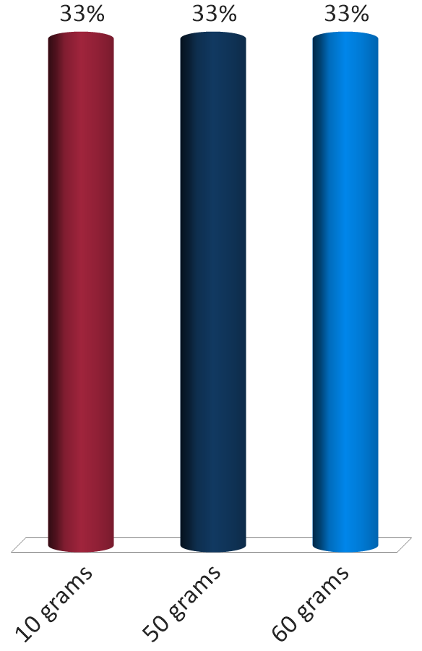
Bob Ross was arrested and charged with possession with intent to distribute 10 grams heroin to an undercover officer on May 1, 2021. The government proved that Mr. Ross has sold this same undercover officer 10 grams of heroin on five other occasions in April 2021.
What quantity of heroin will Ross be held accountable for under 2D1.1?
10 grams
50 grams
60 grams
Notes:
United States v. Sarchett, 3 F.4th 1115 (8th Cir. 2021). The court clearly erred in finding that the defendant was responsible for additional drug quantity. Although the parties stipulated that precursor materials were found in the defendant’s girlfriend’s home and car, the stipulation did not sufficiently connect the defendant to those places.

Slide 7
Same Course of Conduct
§1B1.3(a)(2), App. Note 5(B)(ii)
Similarity
Regularity
Temporal Proximity

Slide 8
Common Scheme or Plan
§1B1.3(a)(2), App. Note 5(B)(i)
Common Victims
Common Accomplices
Common Purpose
Similar Modus Operandi

Slide 9
Drug Trafficking Guideline
USSG §2D1.1

Slide 10
Weapon enhancement
Maintaining a drug premises
Common §2D1.1 Application Issues
Safety Valve
Base offense level when
death results

Slide 11
USSG §2D1.1(b)(1)
If a dangerous weapon (including a firearm) was possessed, increase by 2 levels.
If both the weapon and drugs are present, then SOC applies unless “clearly improbable.”
Notes:
11
11

Slide 12
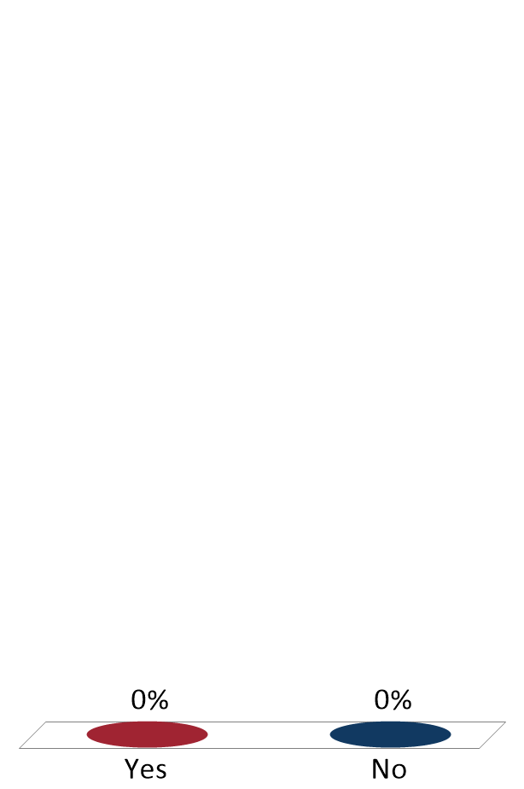
Defendant has pleaded guilty to drug trafficking. The drugs were found in a closet in the defendant’s bedroom. During the search, officers also found a firearm under the bed in the same room as the drugs.
Does the 2-level weapons enhancement under §2D1.1(b)(2) apply in this case?
Yes
No

Slide 13
USSG §2D1.1(b)(12)
If the defendant maintained a premises for the purpose of manufacturing or distributing a controlled substance, increase by 2 levels.
Notes:
13
13

Slide 14


Premises Enhancement
{{{{
{{{{
Maintained
Possessory interest
Control of the premises
The Purpose
Need not be sole purpose
Compare frequency of drug trafficking v. lawful purpose
Notes:
14
14

Slide 15
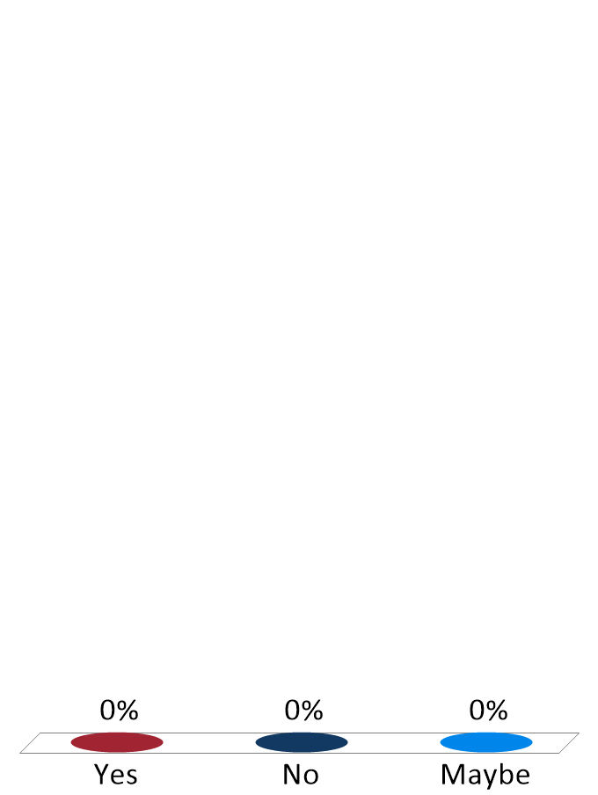
Mr. Thomas was arrested and charged with possession with intent to distribute marijuana. He was arrested in an apartment and law enforcement officers found 50 pounds of marijuana, scales, baggies, and other drugs paraphernalia. The apartment was leased to Thomas’ girlfriend.
Will the enhancement for maintaining a drug premises under §2B1.1(b)(12) apply?
Yes
No
Maybe
Notes:
United States v. Jefferson, 975 F.3d 700 (8th Cir. 2020). The court did not clearly err in applying §2D1.1(b)(12)’s 2-level enhancement for maintaining a drug premises. While the defendant’s name was not on the lease, he directed customers to pick up drugs from the home and stored drugs and drug paraphernalia there.

Slide 16
Safety Valve Criteria
USSG §5C1.2
Defendant does not have more than 1 Criminal History Point;
Defendant did not use violence/threats of violence or possess a firearm or other dangerous weapon in connection with the offense;
Offense did not result in death or serious bodily injury;
Defendant was not an organizer/leader/ manager/supervisor…; and
Not later than the time of the sentencing hearing, defendant has truthfully provided to the government all information.

Slide 17
Safety Valve Limitations
Old Limitation
The defendant does not have:
more than 1 criminal history point.
New Limitation
The defendant does not have:
more than 4 criminal history points, excluding any criminal history points resulting from a 1-point offense;
a prior 3-point offense; and
a prior 2-point violent offense.

Slide 18
What does the new limitation mean?
Circuit Split
Defendant disqualified from safety valve if any one of the three limitations is satisfied.
Defendant disqualified from safety valve only if all three limitations are satisfied.
US v. Lopez, 998 F.3d 431 (9th Cir. 2021)
Notes:
US v. Garcon, 997 F.3d 1301 (11th Cir. 2021) – recently vacated – now being heard en banc.

Slide 19
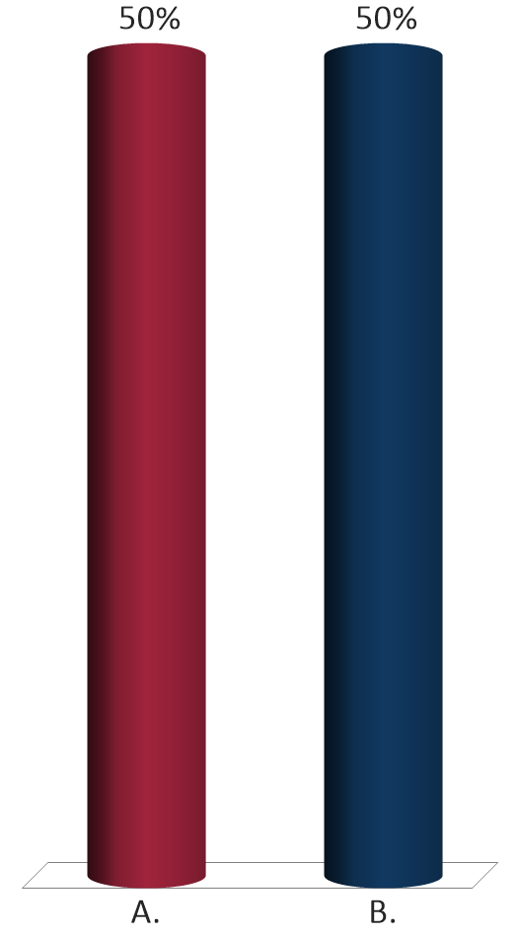
Donald Ressler was convicted of a heroin trafficking conspiracy. Ressler argues for safety valve, but the government objects because Ressler’s co-defendant carried a firearm. Ressler received a §2D1.1(b)(1) increase for his co-defendant’s firearm.
Is Mr. Ressler ineligible for safety valve because of the firearm?
Yes
No

Slide 20
USSG §2D1.1(a) Base Offense Levels
43
43, if the defendant was convicted under 21 U.S.C. 841 … and the offense of conviction establishes that death or serious bodily injury resulted from the use of the substance and the defendant has a prior conviction for a similar offense.
38, if the defendant was convicted under 21 U.S.C. 841 … and the offense of conviction establishes that death or serious bodily injury resulted from the use of the substance.
38

Slide 21
“Offense of Conviction” v. “Offense”
Offense of Conviction
Limited to what is contained in the charging document
Does not include relevant conduct
Narrower than “offense”
Offense
Includes the offense of conviction and all relevant conduct
Broader than “offense of conviction”
Notes:
United States v. Hodgkiss, 960 F.3d 1110 (8th Cir. 2020). Statutory eligibility for safety valve excludes a defendant who possesses a firearm or other dangerous weapon in connection with the offense. In this context, “offense” means “offense of conviction,” not a defendant’s “relevant conduct” as determined by the Guidelines. A defendant who pleaded to a drug distribution offense (April 2018) was eligible for statutory safety valve despite a § 924(c) conviction (June 2018) relating to another drug offense.

Slide 22
Firearms Guideline
USSG §2K2.1

Slide 23
Base offense level
Stolen or obliterated serial number
Common §2K2.1 Application Issues
Trafficking in firearms
Use of a firearm in connection with another offense

Slide 24
Base Offense Level Determined By Various Factors
Status
  “felon-in-possession”
  “straw purchaser”
Type of firearm
Prior convictions
“crimes of violence”
“controlled substance offenses”
Notes:
United States v. Miller, 11 F.4th 944 (8th Cir. 2021). The higher base offense levels at §2K2.1 for offenses involving “a firearm described in 26 U.S.C. § 5845” do not require proof of a mental state.

Slide 25
Stolen Gun/Obliterated Serial Number SOC
§2K2.1(b)(4), App. Note 8
Strict liability standard
If any firearm:
was stolen,
increase by 2 levels
  had an altered or obliterated serial number,
  increase by 4 levels.
OR
(cannot give both; use the greater)

Slide 26
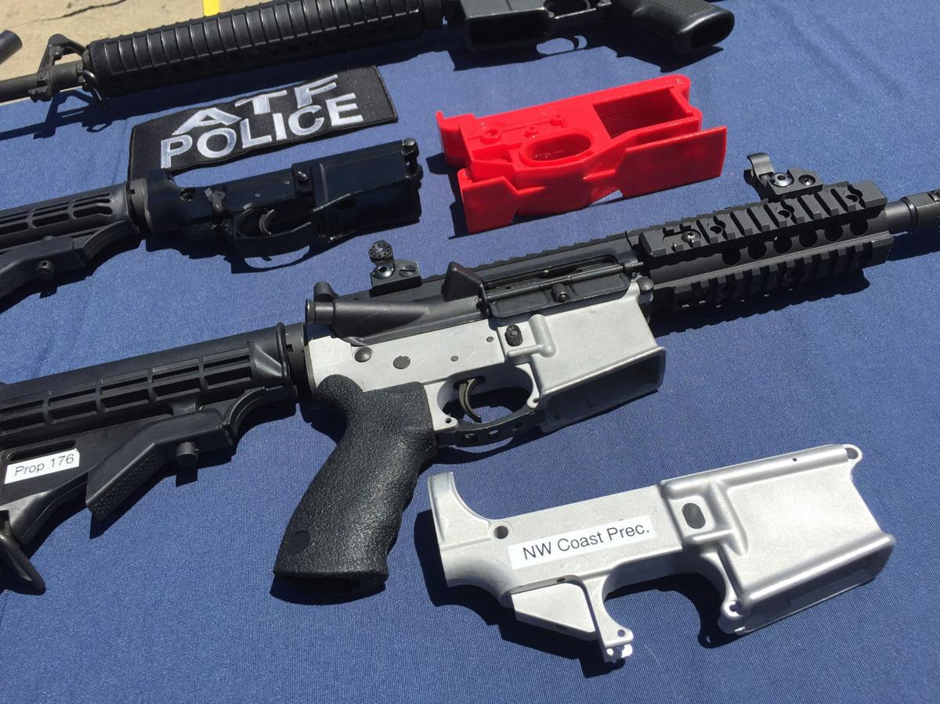
Ghost Gun
What is it?

Slide 27
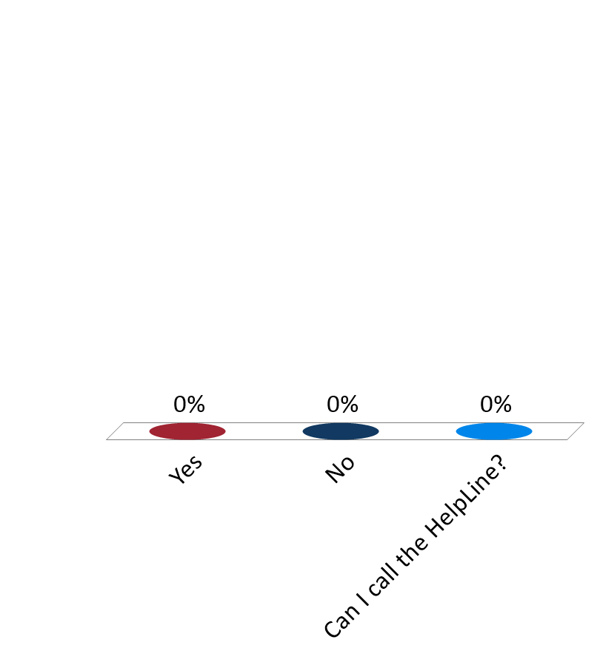
Mr. Casper was convicted of Felon in Possession of a Firearm. In this case, the firearm is a “ghost gun.”
Should the USPO apply the § 2K2.1(b)(4)(B) enhancement because the firearm has an altered or obliterated serial number?
Yes
No

Slide 28
Trafficking Firearms
Section 2K2.1(b)(5)
If the defendant engaged in the trafficking of firearms, increase by 4 levels.

Slide 29
Trafficking Firearms
Key Points:
  Transfers two or more firearms to an individual whose possession is unlawful
  Unlawful possession is narrowly defined

Slide 30

The defendant pled guilty to one count of felon in possession (§2K2.1). The defendant, during the offense, provided the CI with a total of three firearms. The CI told the defendant that he “had to be careful” when obtaining guns because he has a felony record.
Does the SOC for trafficking of firearms at §2K2.1(b)(5) apply?
Yes
No

Slide 31
Use “in connection with” another offense
Section 2K2.1(b)(6)(B)
If the defendant:
  Used or possessed any firearm or ammunition in connection with another felony offense
  Increase by 4 levels, with a floor of BOL 18

Slide 32
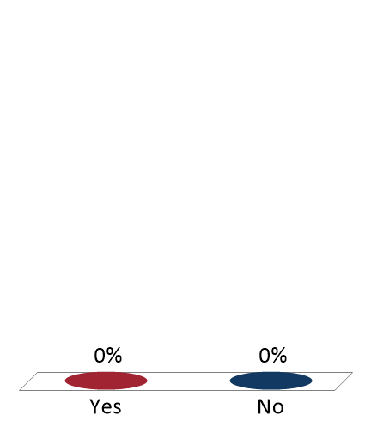
During approximately a one-month period, Emerson sold undercover ATF agents a total of six firearms and .15 grams of heroin. The sale of the .15 grams of heroin did not occur on the same day as any of the sales of the firearms. Although Emerson discussed selling both guns and illegal drugs (heroin and cocaine) to the ATF undercover agent, he was never observed to be in possession of weapons and illegal drugs at the same time.
Does the SOC for use or possession of a firearm in connection with another felony offense at §2K2.1(b)(6)(B) apply in this case?
Yes
No

Slide 33
§2K2.1(b)(6)(B) & (c)(1) & App. Note 14
Apply if the firearm or ammunition facilitated, or had the potential of facilitating, another felony offense.
Special rule for burglary or drug trafficking:
  When a firearm is taken in a burglary
  When a firearm is in close proximity to drugs or drug paraphernalia
Can be based on any federal, state, or local offense.

Slide 34
“In connection with” Differences Explained
Use/Possession SOC - §2K2.1(b)(6)(B)
“Used or possessed any firearm or ammunition in connection with another felony offense.”
Use/Possession Cross Reference - §2K2.1(c)
“Used or possessed any firearm or ammunition cited in the offense of conviction in connection with … another felony offense.”

Slide 35
18 U.S.C. § 924(c)
Carry, use, or possess a firearm in relation to a “crime of violence” or a “drug trafficking crime” with mandatory minimums depending on:
Whether firearm was:
used, carried, or possessed (5 years)
brandished
(7 years)
discharged
(10 years)
AND
Type of firearm:
short-barreled rifle, short-barreled shotgun, semiautomatic assault weapon (10 years)
machine gun, destructive device, or equipped with silencer or muffler
(30 years)

Slide 36
Impact of § 924(c) on SOCs
§2K2.4, App. Note 4 (p. 259)
Do not apply the firearm (weapon) SOC in guideline for the underlying offense, for example:
  §2D1.1(b)(1)
  §2K2.1(b)(6)(B)

Slide 37
Other Issues for Drug and Firearm Offenses
If you have both drug and gun convictions, these offenses will likely group together.
If you have a drug conviction, possible career offender.
If you have a felon-in-possession conviction, possible ACCA.

Slide 38
Learning Outcomes
You should now be able to:
Describe relevant conduct principles in gun and drug cases;
Apply common specific offense characteristics in drug offenses;
Apply common specific offense characteristics in firearms offenses;
Identify common applications issues when the offense involves drugs and firearms.

