Slide 1
Sex Offenses
May 12, 2022
U.S. Sentencing Commission
Office of Education and Sentencing Practice
This presentation is produced and disseminated at U.S. taxpayer expense.

Slide 2
Learning Objectives
By the end of today’s session, participants will be able to:
Describe the relevant conduct analysis that applies for offenses involving child pornography;
Apply certain Specific Offense Characteristics (SOCs) correctly; and
Apply the Special Instructions correctly.

Slide 3
Chapter Two Guidelines and Statutes
Guideline | Statute | Description
§2G1.3 | 18 U.S.C. §§ 1591, 2422, 2423 | Trafficking/Travel of Minors
§2G2.1 | 18 U.S.C. § 2251 | Production
§2G2.2 | 18 U.S.C. §§ 2252 & 2252A | Traffic, Receipt, Possession
Notes:
18 USC 2421 – Transportation - Whoever knowingly transports any individual in interstate or foreign commerce, or in any Territory or Possession of the United States, with intent that such individual engage in prostitution, or in any sexual activity for which any person can be charged with a criminal offense, or attempts to do so, shall be fined under this title or imprisoned not more than 10 years, or both.
18 USC 2422 – Coercion and Enticement - (a)Whoever knowingly persuades, induces, entices, or coerces any individual to travel in interstate or foreign commerce, or in any Territory or Possession of the United States, to engage in prostitution, or in any sexual activity for which any person can be charged with a criminal offense, or attempts to do so, shall be fined under this title or imprisoned not more than 20 years, or both.
(b)Whoever, using the mail or any facility or means of interstate or foreign commerce, or within the special maritime and territorial jurisdiction of the United States knowingly persuades, induces, entices, or coerces any individual who has not attained the age of 18 years, to engage in prostitution or any sexual activity for which any person can be charged with a criminal offense, or attempts to do so, shall be fined under this title and imprisoned not less than 10 years or for life.

Slide 4
Statutory Penalty Scheme for Selected Sex Offenses
4
Mandatory Minimums and Statutory Maximums
 | Possession | Receipt/Distribution/ Transportation of Child Pornography | Production
1st Time Offender | 0 – 10 years 20 Year Max if > age 12 | 5 - 20 years | 15 -30 years
Recidivist (Prior Sex Conviction) | 10 - 20 years | 15 – 40 years | 25 – 50 years

Slide 5
§2G2.2

Slide 6
§2G2.2: Distribution/Receipt/Possession
Base offense level depends on offense of conviction:
18
possession offenses
22
receipt or trafficking offenses

Slide 7
Relevant Conduct Analysis
WHEN:
Offense of Conviction
In preparation
During
Avoiding detection
Same course of conduct/ common scheme or plan

Slide 8
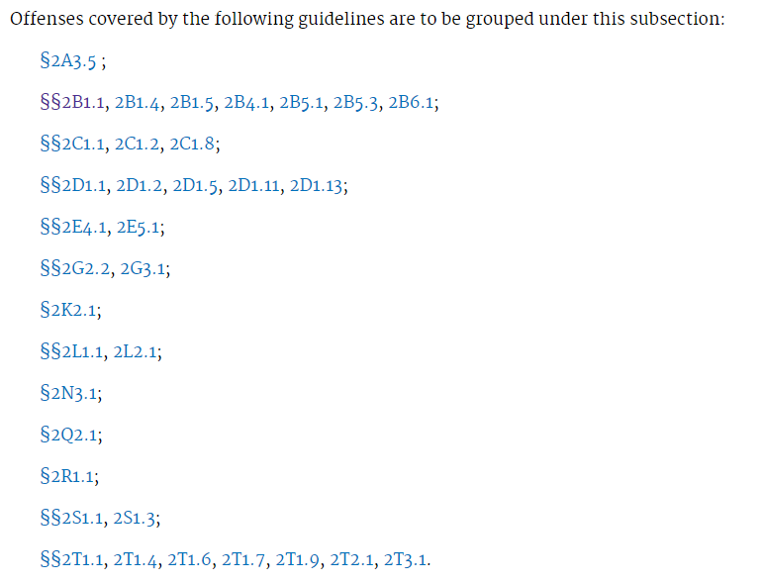
Offenses for Which “Expanded” Relevant Conduct Applies
The applicable Chapter Two guideline must be included in this list at §3D1.2(d).

Slide 9
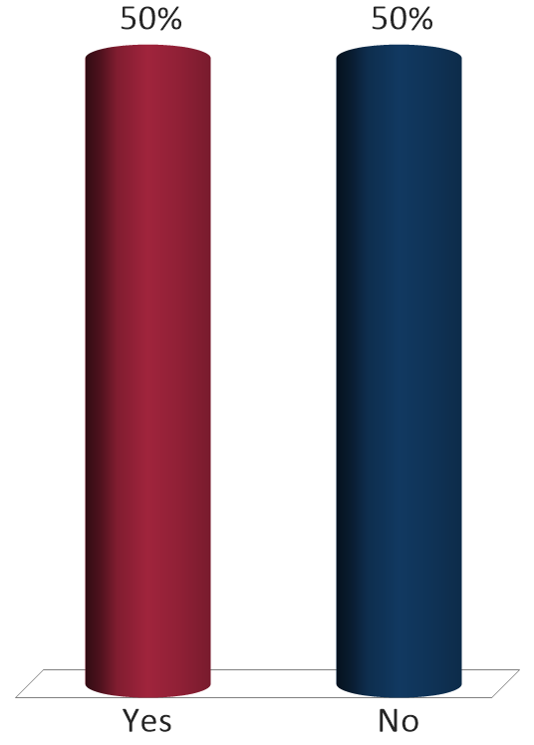
The defendant is convicted of one count of possession of a video of child pornography involving a 14-year-old child on June 1, 2020. One month earlier, the defendant also distributed a child pornography video of a 6-year-old engaged in sexual activity. Can the court use the video involving the 6-year-old to apply §2G2.2(b)(1) for material involving a minor under 12?
Yes
No

Slide 10
§2G2.2 SOCs 2020
(b)(1): 2-level decrease for receipt (13.1%)
(b)(2): victim under 12 (93.6%)
(b)(3): distribution (49.1%)
(b)(4): S/M enhancement/infants or toddlers (81.5%)
(b)(5): Pattern of activity (15.8%)
(b)(6): Use of a computer (94.2%)
(b)(7): Number of images (93.6%)

Slide 11
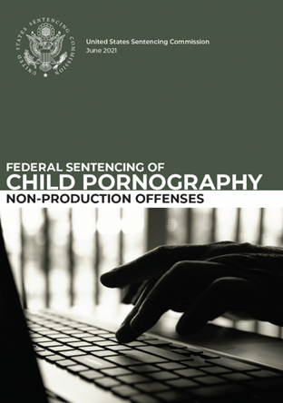
Federal Sentencing – Non-Production Offenses
Content
Community
Conduct

Slide 12
§2G2.2(b)(1): Receipt (2-level Decrease)
If the defendant’s conduct was limited to the receipt or solicitation of the material involving sexual exploitation of the minor and the defendant did not intend to traffic or distribute the material.

Slide 13
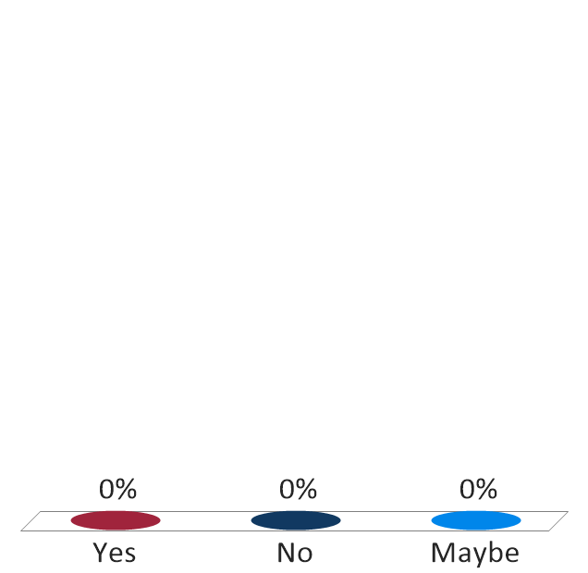
Defendant is convicted of one count of receipt of child pornography on June 1, 2020. Defendant used a file sharing program to download images of child pornography. Defendant claims he should get the two-level reduction for “conduct limited to receipt of child pornography.“ Should the reduction apply?
Yes
No
Maybe

Slide 14
§2G2.2(b)(3)(f): Distribution 2-Level
Applies “if the defendant knowingly engaged in distribution.”
Mens rea requirement: knowingly

Slide 15
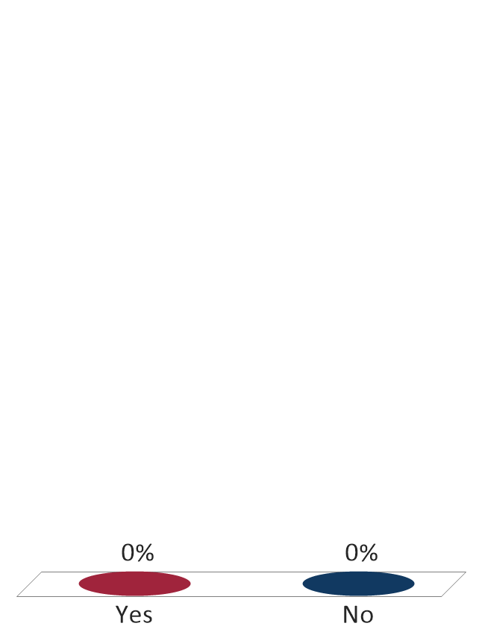
The government argues that the 2-level increase for distribution under §2G2.2(b)(3)(F) applies. The defendant claims he doesn’t know how file sharing programs work and did not know the images were being distributed. The defendant is a computer technician and has a degree in computer science. Should the enhancement apply on these facts?
Yes
No
Notes:
“The court below reasonably could infer that the defendant was a sophisticated computer user based on evidence that he had acquired two degrees in computer science and computer networks.”
U.S. v. Lawrence, 920 F.3d 331 (5th Cir. 2019)

Slide 16
§2G2.2(b)(3)(B): 5-level Distribution
Applies: If defendant knowingly exchanges with another person for the specific purpose of obtaining something of valuable consideration from that other person.
Notes:
US v. Smith 910 F.3d 1047 (8th Cir. 2018)

Slide 17
§2G2.2(b)(5): Pattern of Activity
If defendant engaged in pattern of activity involving the sexual abuse or exploitation of a minor, increase by 5-levels.

Slide 18
Key Points for Pattern SOC
No conviction required
No time limit on conduct
Can include conduct when defendant was a minor

Slide 19
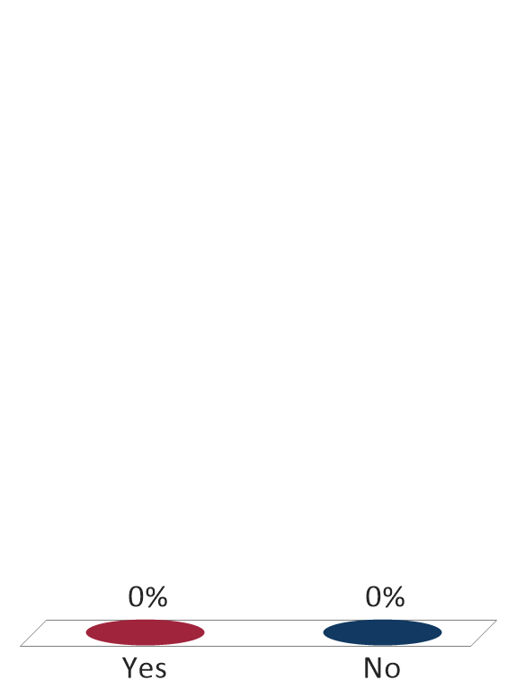
The defendant is convicted of possession of child pornography. The defendant’s stepdaughter testified at the sentencing hearing that the defendant sexually abused her on numerous occasions 30 years ago when she was 14. The government is arguing for application of §2G2.2(b)(5), the 5-level “pattern of activity” enhancement. The defendant admits the conduct occurred but argues the SOC can’t apply because he was not convicted and because it occurred 30 years ago. Should the enhancement apply?
Yes
No

Slide 20
What if Offense Involves Production?
Cross Reference to §2G2.1 (Production)
Relevant conduct determination
Notes:
US v. Steffen, 818 F.3d 770 (8th Cir. 2016)

Slide 21
§2G2.1

Slide 22
§2G2.1: Production Common SOCs
(b)(1)(A) – Age of victim – Under 12 – 42%
(b)(1)(B) – Victim between 12 and 16 – 43.9%
(b)(2)(A) – Sex act or sexual contact – 59.4%
(b)(3) – Distribution – 31.2%
(b)(4)(A) – S/M enhancement – 13.6%
(b)(5) – Victim in care or custody of defendant – 44.8%
Notes:
United States v. Raiburn, 20 F.4th 416 (8th Cir. 2021). Sexual contact under §2G2.1(b)(2)(A) and 18 U.S.C. § 2246(3) includes masturbation. Intentional touching of “ʻany person’ applies to all persons, including [the defendant] himself.”

Slide 23
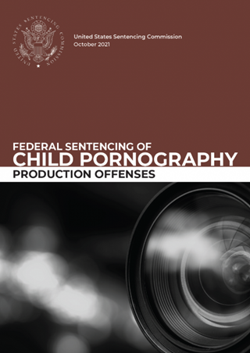
Federal Sentencing – Production Offenses
Proximity
Participation
Propensity

Slide 24
Offenses excluded at §3D1.2(d) “Expanded Relevant Conduct does not apply”
Robbery
Assault
Murder
Kidnapping
Criminal Sexual Abuse
Extortion
Blackmail
Burglary
Production of Child Pornography

Slide 25
§1B1.3 Analysis
WHEN:
Offense of Conviction
In preparation
During
Avoiding detection
Same course of conduct/ common scheme or plan

Slide 26
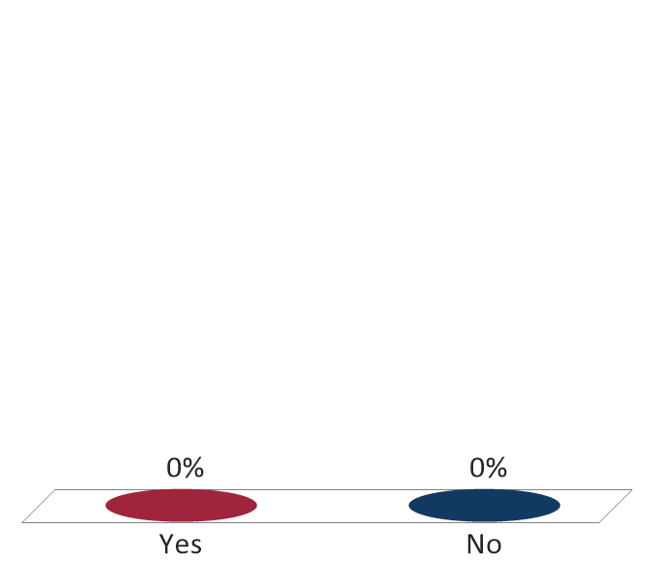
The defendant is convicted of one count of production of child pornography, citing Minor A, age 14, exploited during the production on July 15, 2020. Two weeks later, the defendant also produced child pornography exploiting Minor B, age 10. Does the SOC at 2G2.1(b)(1)(A) – involved a minor who had not attained the age of 12 - apply?
Yes
No

Slide 27
Special Instruction
§2G2.1(d)(1) & App. Note 5
If the offense involved the exploitation of more than one minor, each minor shall be treated as if contained in a separate count of conviction.
Multiple counts involving more than one minor are not to be grouped together.

Slide 28
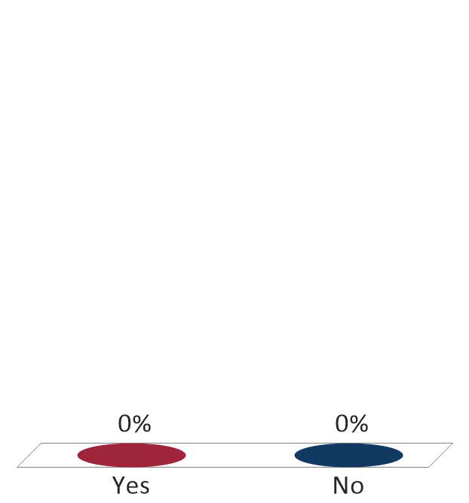
The defendant is convicted of one count of production of child pornography. The indictment cites one minor, age 10, exploited during the production on a May 10, 2020. The discovery also includes another image that shows a second minor, age 9, being exploited on May 15, 2020. Will the special instruction at §2G2.1(d) be applied?
Yes
No

Slide 29
§2G1.3

Slide 30
§2G1.3: Travel Cases and Child Sex Trafficking
Base Offense Levels:
34 - § 1591(b)(1) – victim under 14
30 - § 1591(b)(2) – victim between 14-18
28 - §§ 2422(b) or 2423(a) – enticement/transport of minor
24 - otherwise

Slide 31
18 U.S.C. § 1594(c) Conspiracy Convictions
§1B1.3, App. Note 7 -
Treat conspiracies the same as the substantive offense.
§2X1.1, App. Note 2 –
the base offense level will be the same as that for the substantive offense.
Notes:
What does that look like – Conspiracy to Commit 18 USC 1591.

Slide 32
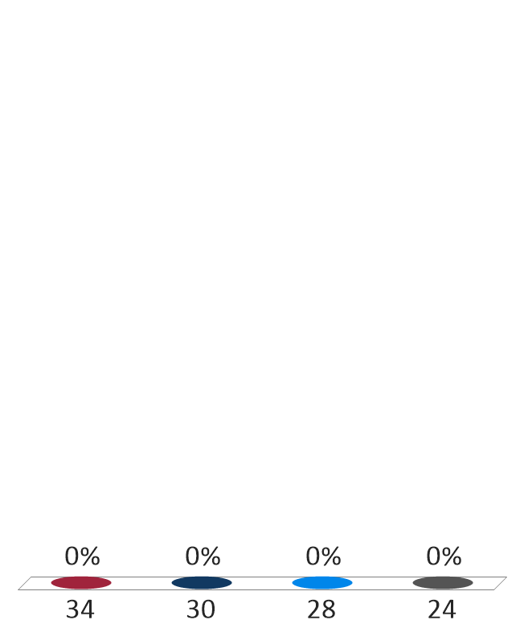
The defendant is convicted of conspiracy to engage in sex trafficking by force, fraud, or coercion, 18 U.S.C. § 1594(c). The indictment described the conspiracy as one “to cause ‘Victim 4’ to engage in a commercial sex act, in violation of 18 U.S.C. § 1591(a)(1).“ Which of the four base offense levels at §2G1.3 should apply?
34
30
28
24
Notes:
US v. Carter, 960 F.3d 1007 (8th Cir. 2020)

Slide 33
§2G1.3 Specific Offense Characteristics
33
(b)(2)(B) – Undue influence – 33.7%
(b)(3)(A) - Use of a computer to persuade – 42.7%
(b)(3)(B) – Use of a computer to solicit – 42.7%
(b)(4)(A) – Commission sex act or contact – 42.2%

Slide 34
§2G1.3(b)(2)(B) Undue Influence
34
Consider facts to determine if defendant’s influence over the minor compromised the voluntariness of minor’s behavior
Rebuttable presumption 10-year age difference
Doesn’t apply in “sting cases”

Slide 35
§2G1.3 Cross References Example
35
Count 1 Cross Reference
Production of child pornography.
Count 1
Transportation of a 14-year-old for purposes of illegal sexual activity, production of child pornography on March 20, 2016.
§2G1.3
§2G2.1
BOL 32
(b)(1) (Minor under 16) +2
(b)(2)(A) (Sexual Act) +2
(b)(6) (False Identity and Computer) +2
Total Offense level of 38
Guideline: §2G1.3
BOL 28
(b)(2) (False Identity) +2
(b)(3) (Use of Computer) +2
Total Offense level of 32

Slide 36
§2G1.3(d)(1): Special Instruction
36
If the offense involved the exploitation of more than one minor, each minor shall be treated as if contained in a separate count of conviction.
Multiple counts involving more than one minor are not to be grouped together.

Slide 37

The defendant is convicted of one count of transportation of a 15-year-old minor on July 13, 2020. The defendant transported two minors to meet up with an individual for sex. In addition to the 15-year-old minor cited, there was also an 11-year-old being transported for prostitution. Will the special instruction at §2G1.3 apply?
Yes
No

Slide 38
Other Issues Sex Offenses
Repeat and Dangerous Sex Offender Against Minor – §4B1.5
Instant offense is a covered sex crime and has one prior sex offense conviction
(b) Instant offense is a covered sex crime, and the defendant engaged in a pattern of activity involving prohibited sexual conduct

Slide 39
Learning Outcomes
Now, you should be able to:
Describe the relevant conduct analysis that applies for offenses involving child pornography;
Apply certain Specific Offense Characteristics (SOCs) correctly; and
Apply the Special Instructions correctly.

